Slide 1

Data Structures & Algorithms
EDYODA

Slide 2
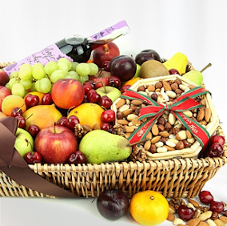
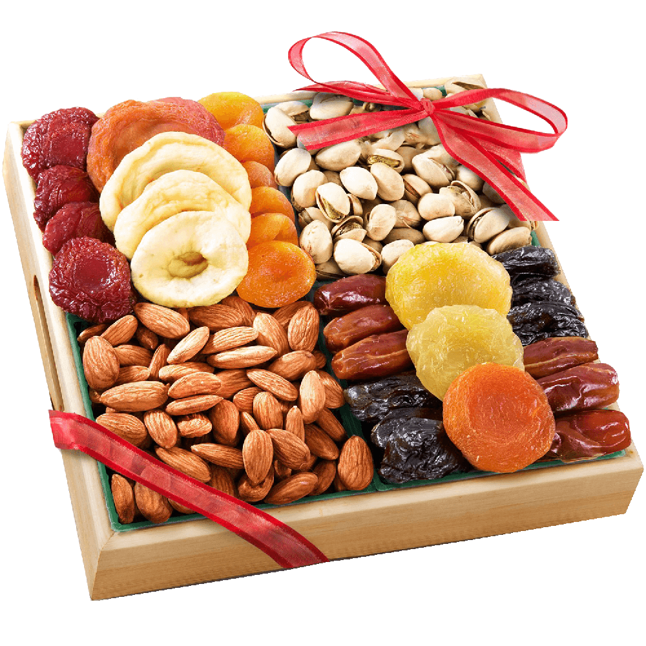
What is a Data Structure?
It is a way to organize data that enables it to be processed in an efficient time.
Some of the more commonly used data structures include – linked lists, arrays, stacks, queues, heaps, trees, and graphs.
EDYODA

Slide 3
What is an algorithm?
Is a set of rules to be followed to solve a problem.
To solve that problem we will be using some data structure.
Example you want to prepare something from the data.
EDYODA

Slide 4
Types of Data Structure (DS)
ADT : Abstract Data Types
Types
Primitive
Non-Primitive
Integer
Physical
Logical (ADT)
Float
Array
Stack
Boolean
Link List
Queue
Tree
Graph

Slide 5
Linear and Non-Linear DS (Non – Primitive)
Linear Data Structure: Data structure where data elements are arranged sequentially or linearly where the elements are attached to its previous and next adjacent in what is called a linear data structure. In linear data structure, single level is involved. Therefore, we can traverse all the elements in single run only. Linear data structures are easy to implement because computer memory is arranged in a linear way. Its examples are array, stack, queue, linked list, etc.
Non-linear Data Structure: Data structures where data elements are not arranged sequentially or linearly are called non-linear data structures. In a non-linear data structure, single level is not involved. Therefore, we can’t traverse all the elements in single run only. Non-linear data structures are not easy to implement in comparison to linear data structure. It utilizes computer memory efficiently in comparison to a linear data structure. Its examples are trees and graphs.

Slide 6
Why so many DS?
Each DS has its own property
This property is generally unique
Based on the problem statement we select which DS to use
EDYODA

Slide 7
Runtime Analysis
It is a study of runtime of a given algorithm, by identifying its behaviour as the input size for the algo increases.
What is the performance of a given algorithm.
Why do we need to measure the performance of the given algorithm? Basically, it tells us if our algo is good enough to give faster response on bigger data.
EDYODA

Slide 8
Notations in Runtime Analysis
Consider an example of a car/bike, how do one tell about the mileage
Highway -> 20 km/l – Good (Best)
City Traffic -> 10 km/l – Poor (Worst)
Mixed Environment -> 15 km/l - Average
Similarly algo runtimes may be defined as:
Best Case Scenario – Time Taken
Worst Case Scenario – Time Taken
Average Case Scenario – Time Taken
EDYODA

Slide 9
Types of Notations
Omega Ω = 10sec [Best Case Scenario]
Gives the tighter lower bound for a given algorithm
Running time will not be less than this given time
Big O = 100sec [Worst Case Scenario]
Gives the tighter upper bound for a given algorithm
Running time will not be greater than the given time
Theta Θ – [Average Case Scenario]
Decides the upper bound and lower bound are same of not.
Running time of a given algorithm will be on an average be equal too this.
EDYODA

Slide 10
Time Complexity Examples
Say you have to write a program to search a given value in an array
[10, 5, 6, 11, 3,….. 26,……. 20,……… 30]
[1,1,1,,1,1………..m26….m20……….n]
Omega (Ω) – 10 search – Best case scenario Ω(1)
1 : Always guarantees that minimum time required for executing the algo.
Big O – Worst Case Scenario O(n)
n : Algo will not be more than the given time
Theta (Θ) - Average Case Scenario Θ(n/2)
n/2 : On an average it will take n/2 time on an average
EDYODA

Slide 11
What is an Array/List?
Array is a DS consisting of collection of elements each identified by an index. It is stored such that the position of each element can be computed from its index.
For example,
List of Science marks for Class-XII: [89, 78, 95, 92, 91]
List of things to purchase: [“Apples”, “Notebook”, “Highlighters”, “Chocolates”]
In programming languages like Python and JavaScript, arrays are heterogeneous which means you can store different data type values in the same array.
For example,
[“John”, “Wick”, 42, true]
EDYODA

Slide 12
Properties of Array
Array can store values of any single data type. (int, Boolean, float, String)
Every cell of an Array has an unique index.
Index starts with 0.
In programming languages like Python and JavaScript, you do NOT have to specify the length of the array. The length increases when you add more items. The length decreases when you remove items.
EDYODA

Slide 13
What is the need of an Array?
“We want to store 1 million data of some data types”
How do we maintain such list of variables?
We store it in an array!
EDYODA

Slide 14
Types of Arrays
One Dimensional(1D) Array - Line
Multi Dimensional Array
2D - rows and columns, plane
3D – depth, cube
4D
….
ND
EDYODA

Slide 15
Common Operations in an Array
Declaring, instantiating, initializing an Array
Inserting a value
Traversing the array
Accessing a given cell
Searching a given value
Deleting a given value
EDYODA

Slide 16
Declaring, Instantiating, Initializing
Declaration: Create a reference ------ O(1)
arr = []
Instantiating: Create and Array --- O(1), Space Complexity – O(n)
arr = [] * 5
Initialization: Assign values to cells in Array ------- O(n)
arr[0]=10 ---- O(1)
arr[1]=20 ---- O(1)
arr[2]=30 ---- O(1)
arr[3]=40 ---- O(1)
arr[4]=50 ---- O(1)
EDYODA

Slide 17
Inserting New Item in an Array
insertElemAtIndex(arr, value, index) ----------- O(constant) = O(1)
if(arr[index] is occupied) ------------- O (1)
return error --------------------- O (1)
else ---------------------------------------- O (1)
arr[index] = value -------------- O (1)
Time Complexity : O(1)
Space Complexity : O(1)
EDYODA

Slide 18
Traversal of an Array
traverse(arr):
loop i=0 to len(arr) - 1 ------- O(n)
print arr[i] ---------- O(1) | 20*O(1) | 100*O(1) | n * O(1)
Time Complexity : O (n)
Space Complexity : O (1)
EDYODA

Slide 19
Access an Item at Position in an Array
accessElemAtIndex(Arr, index)
if index > len(arr) ------------------ O(1)
return exception ----------- O(1)
else ------------------------------------ O(1)
return arr[index] ----------- O(1)
Time Complexity : O(1)
Space Complexity : O(1)
EDYODA

Slide 20
Searching for an item in an Array
searchInArr(Arr, searchVal)
loop i=0 to len(Arr) -1 ----------------------- O(n)
if arr[i] == searchVal -------------- O(1)
return i --------------------- O(1)
return error -------------------------------- O(1)
Time complexity -> O(n)
Space -> O(1)
EDYODA

Slide 21
Delete an item from an Array
delete(Arr, location)
if arr[location] is occupied --------------------- O(1)
arr[location] = Integer.Min_Value ---- O(1)
else --------------------------------------------------- O(1)
return ---------------------------------------- O(1)
Time Complexity : O(1)
Space Complexity : O(1)
EDYODA

Slide 22
Uses of Arrays
Create Hash Tables
Create Stacks
Create Queues
EDYODA

Slide 23
Stacks
EDYODA

Slide 24
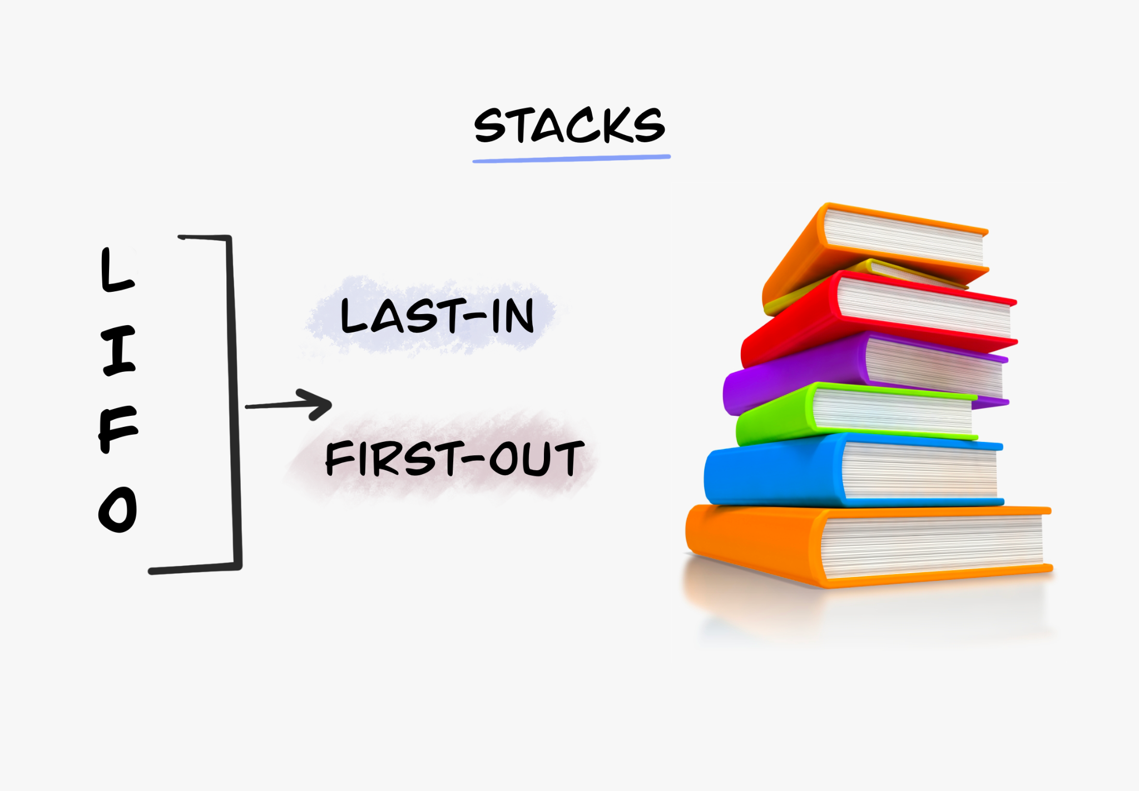

Slide 25
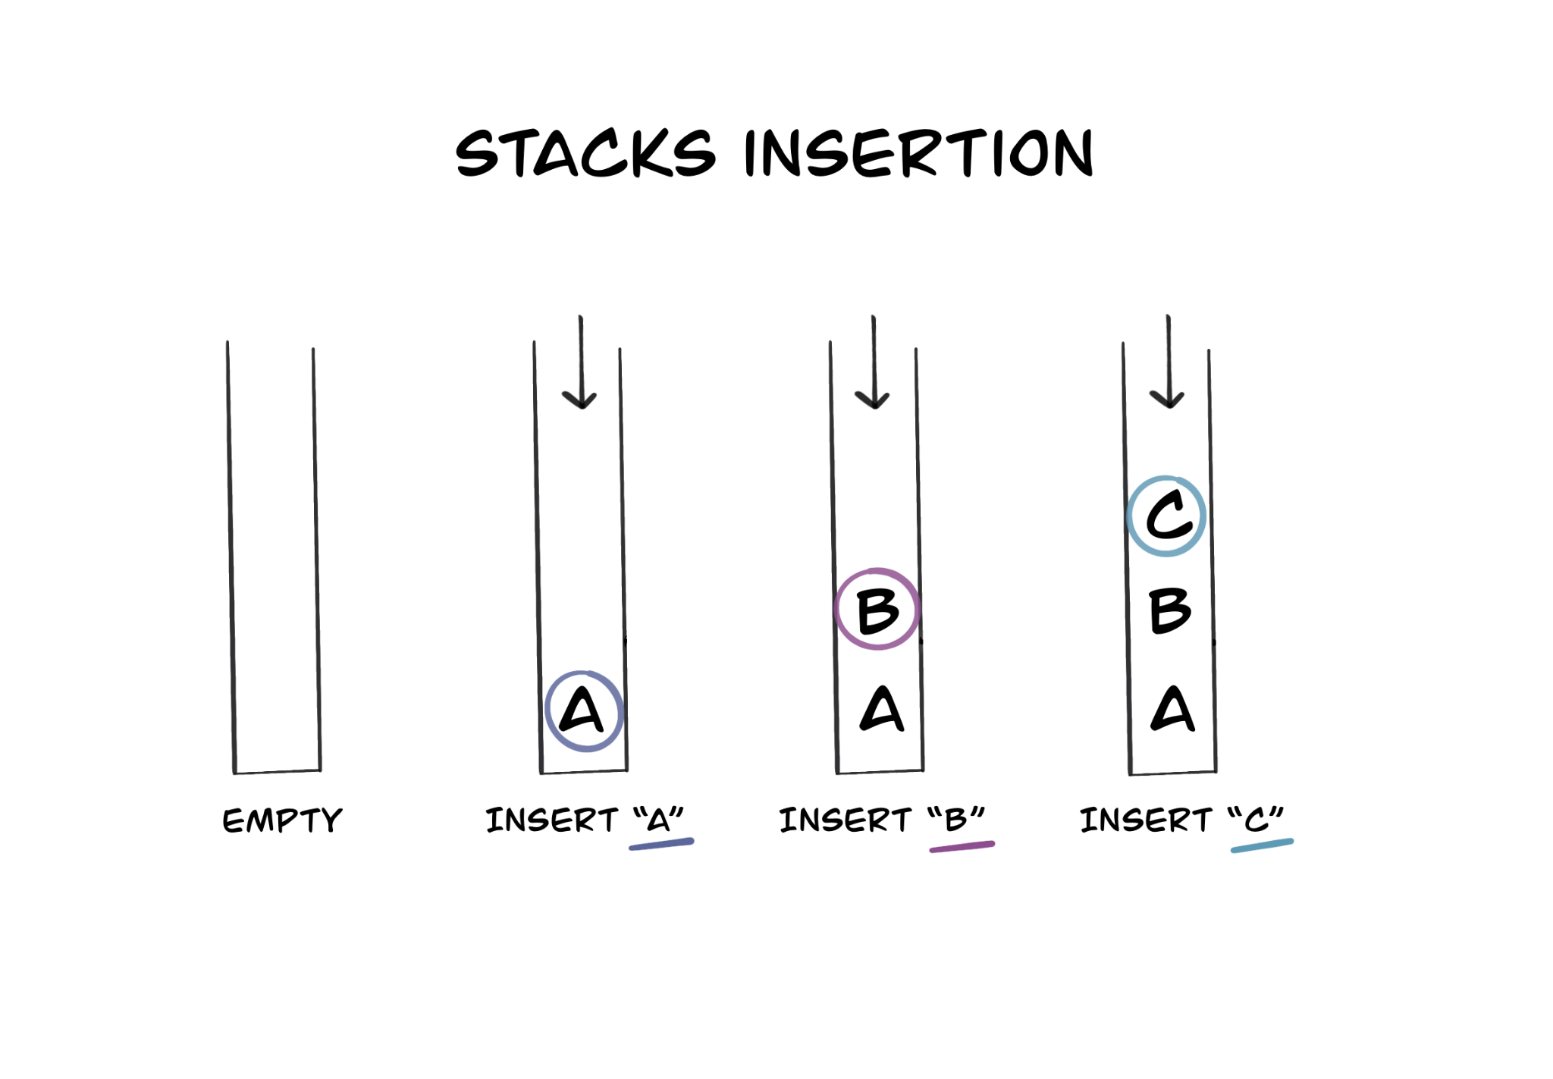

Slide 26
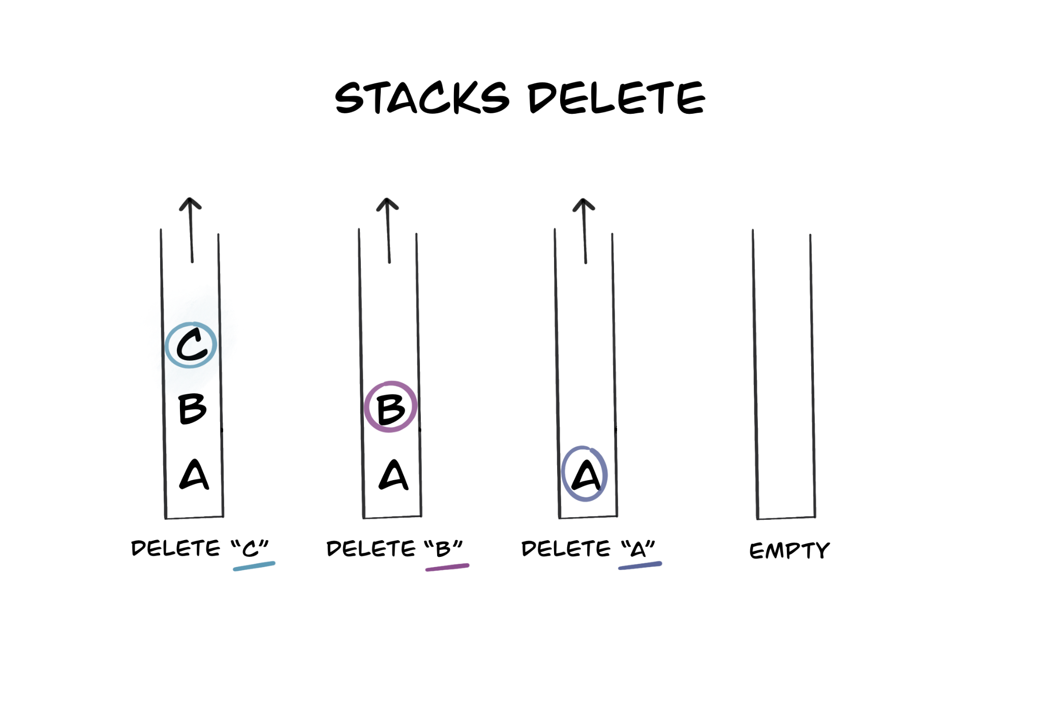

Slide 27
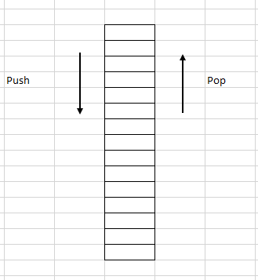
What is stack
Stack is a linear data structure which follows a particular order in which the operations are performed.
Last in First Out (LIFO) property
Can be implemented using
Arrays
Link List

Slide 28
Uses
Back button on browser or in mobile apps
Perform certain mathematical operation like postfix evaluation
Facebook
Twitter
LinkedIn
Quora
Google

Slide 29
Common Operation
Push (Insertion)
Pop (Deletion of a node)
Peek (Shows the data of top element)
IsEmpty – Checks if the stack is empty
isFull() : Only for Array Implementation
Delete (Emptying the whole stack)

Slide 30
Push (Insertion) –
Push(nodeValue)
create node with nodeValue ---------- O(1)
node.next = top ------------------------ O(1)
top = node ------------------------------- O(1)
Time Complexity : O(1)
Space Complexity : O(1)

Slide 31
Pop –
Pop()
if stackIsEmpty() ---------------------------------- O(1)
return error Message------------- O(1)
tempNode = top ------------------------- O(1)
top = top.next -------------------------- O(1)
return tempNode -------------------------- O(1)
Time Complexity : O(1)
Space Complexity : O(1)

Slide 32
Peek
Peek() – Check what is the value at the top most location
return top.value -------------------- O(1)
IsEmpty
IsEmpty()
if top is null --------------------------------- O(1)
return True ------------------------ O(1)
Else ---------------------------------------------- O(1)
return False ------------------------ O(1)

Slide 33
Delete
Delete() – Emptying the whole stack
top=null -------------------------- O(1)

Slide 34
Queues
EDYODA

Slide 35
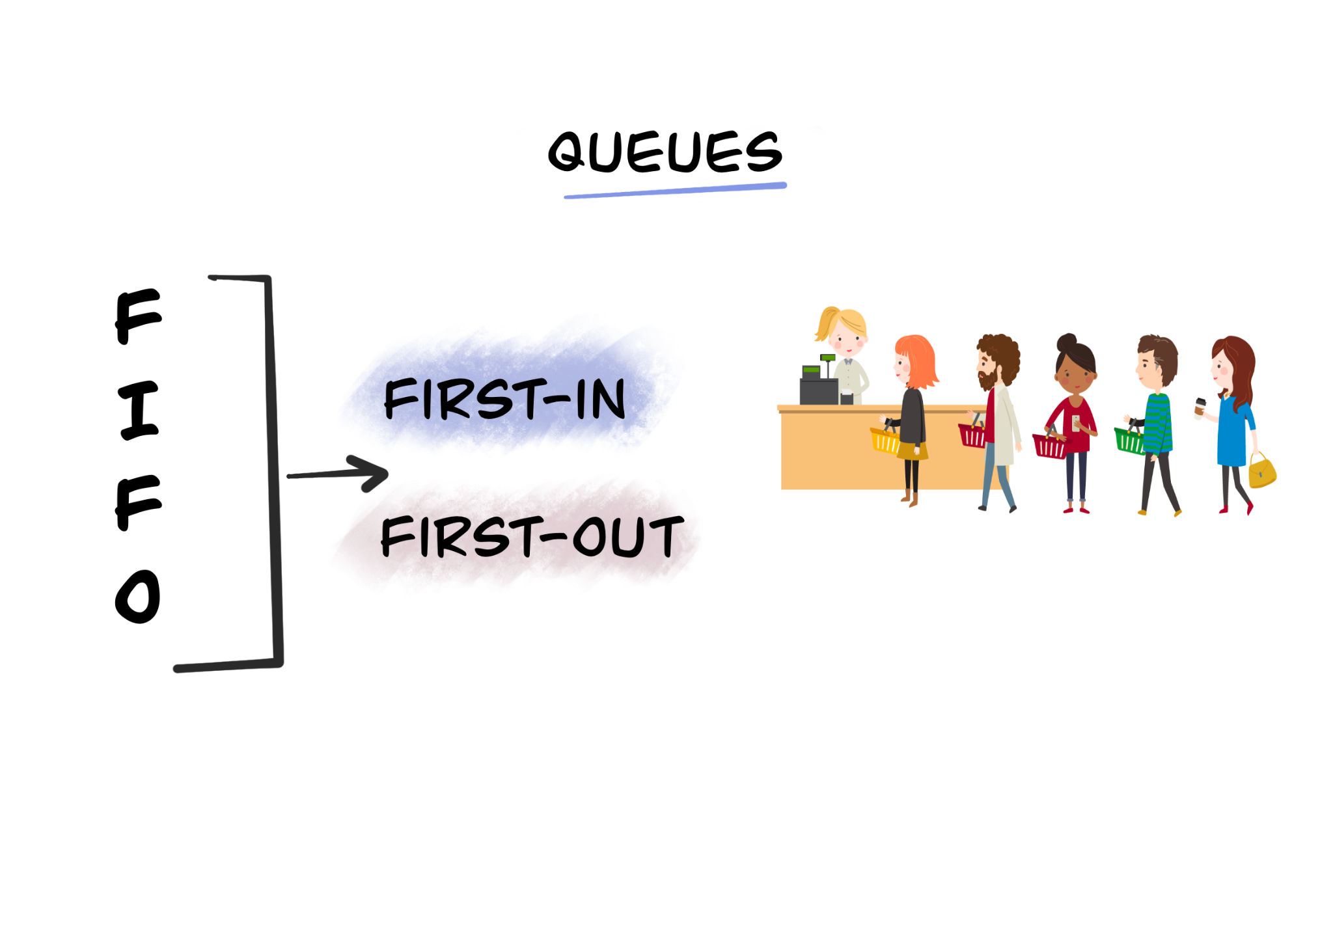

Slide 36
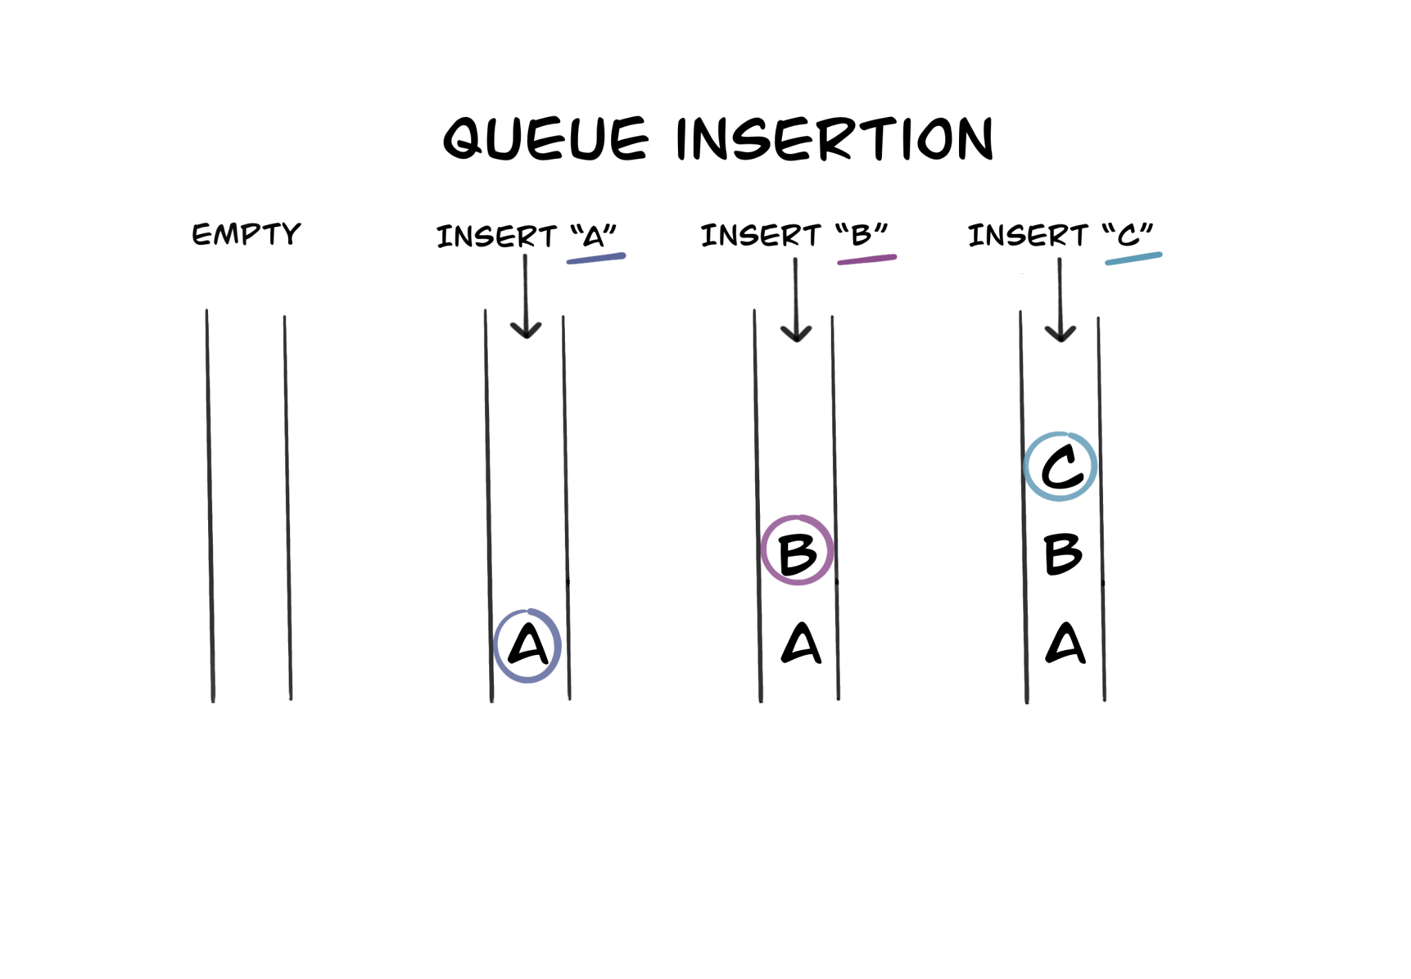

Slide 37
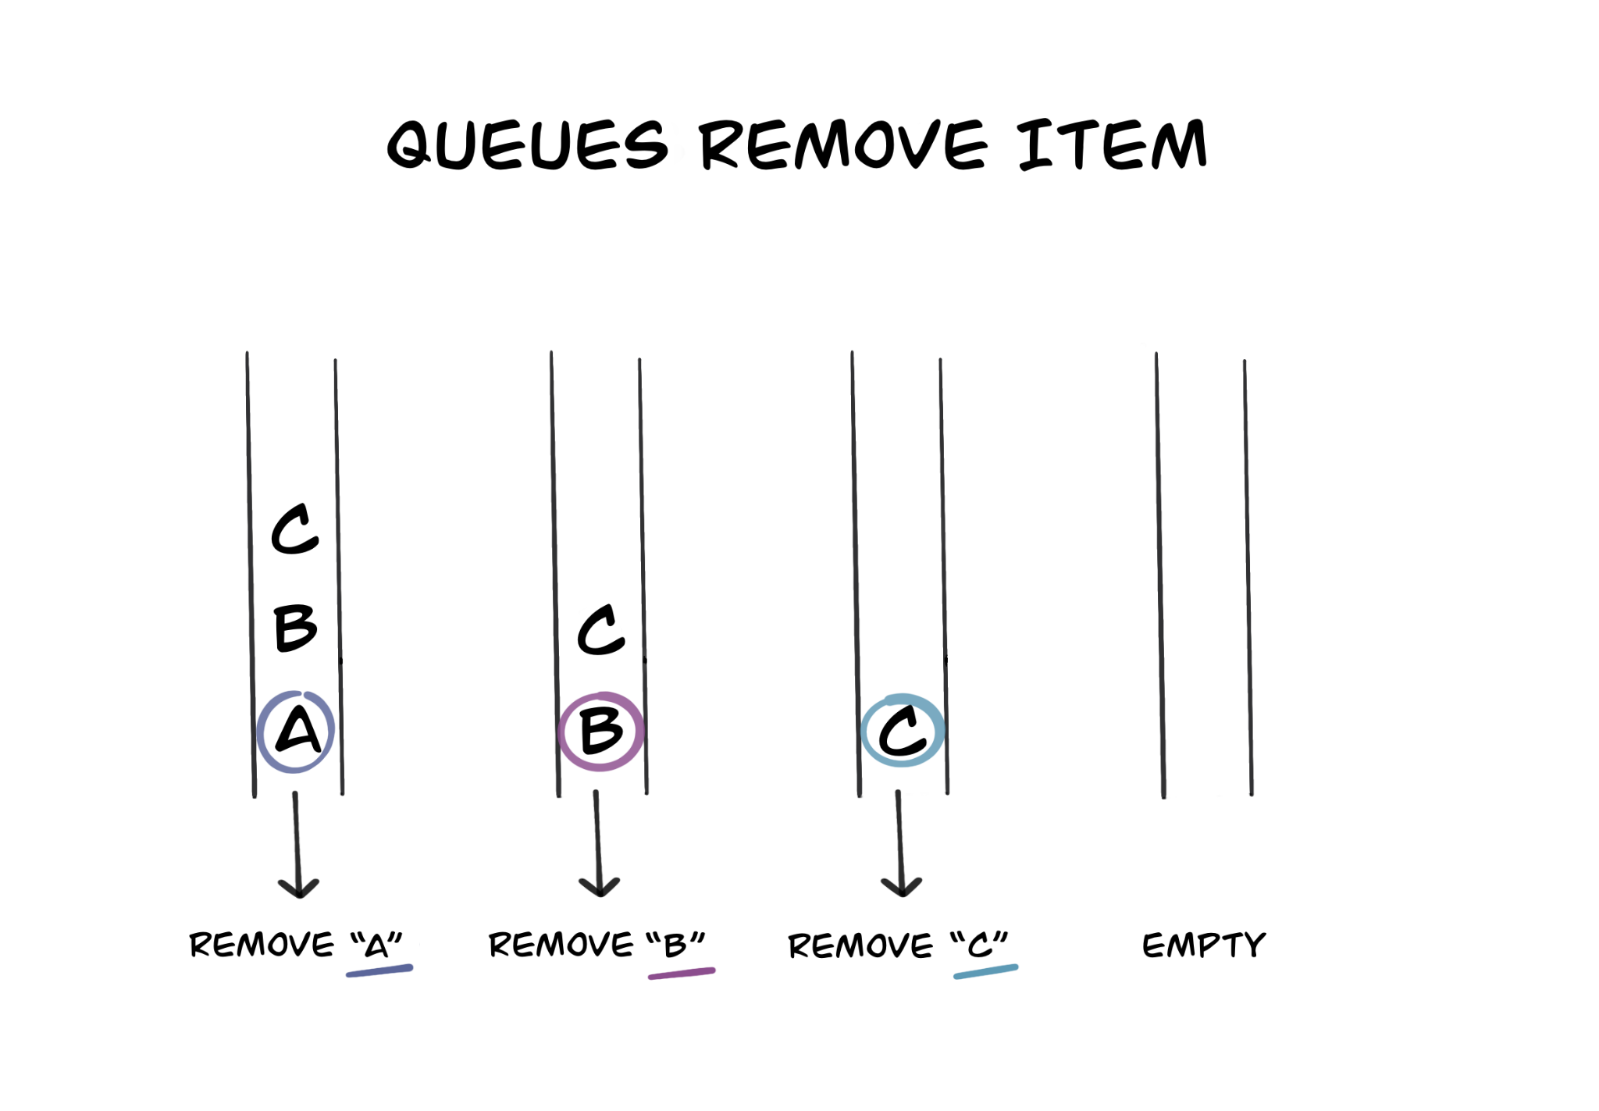

Slide 38

What is queue
Observations
New members addition is at the end of the queue
First person in the queue is the first person to get out of the queue
First In First Out (FIFO)
Example
Billing Counter
Can be implemented using both Arrays and LL

Slide 39
Operations in a Queue
createQueue()
enQueue() – Adding to the queue (at the tail or end)
deQueue() – Removing from the queue (at the start or head)
peekInQueue()
isEmpty()
isFull() : Only for Array Implementation
deleteQueue()

Slide 40
Implementing Queue using LL
CreateQueue()
head = None ---------------- O(1)
tail = None ------------------- O(1)
Time : O(1)
Space : O(1)

Slide 41
Enqueue
Enqueue(nodeValue)
create a New Node --------------------------- O(1)
if tail is None ----------------------------- O(1)
tail = new_node ----------------------- O(1)
head = new_node --------------------- O(1)
else ------------------------------------------------ O(1)
tail.next = new_node ------------------ O(1)
tail = new_node ------------------------ O(1)
Time Complexity – O(1)
Space Complexity – O(1)

Slide 42
Is Empty
isEmpty()
if head is None
return true
else
return false
Time Complexity – O(1)
Space Complexity – O(1)

Slide 43
DeQueue
deQueue()
if isEmpty ---------------------------------------------- O(1)
return error Message ----------------------- O(1)
tmpNode = head ------------------------------------- O(1)
head = head.next ------------------------------------- O(1)
return tmpNode.data -------------------------------- O(1)
Time Complexity – O(1)
Space Complexity – O(1)

Slide 44
Peek
Peek()
if isEmpty()
return error
else
return head.data
Time Complexity - O(1)
Space Complexity – O(1)

Slide 45
Delete
DeleteQueue()
head = None
tail = None
Time Complexity – O(1)
Space Complexity – O(1)

Slide 46
Postfix Evaluation
Read each character in the expression
loop unit expression is empty {
When character read is an operand
- Push to stack
WHen character read is an operator (+, -, /)
- Pop 2 elements from stack
- Perform the mathmetical operation on the 2 operands using the operator
- Push the result from step 2 to stack
}
Peek/pop stack -> This should be the answer of the postfix expression

Slide 47
Linked List
EDYODA

Slide 48
Linked List
A linked list is a sequence of data elements, which are connected together via links. Each data element contains a connection to another data element in form of a pointer.
Each element (Node) consists of 2 components data and pointer.
It is variable in size
Since variable in size much more flexible than array
Array size is static
Linked List is variable (increase/decrease in runtime[execution of the program])

Slide 49
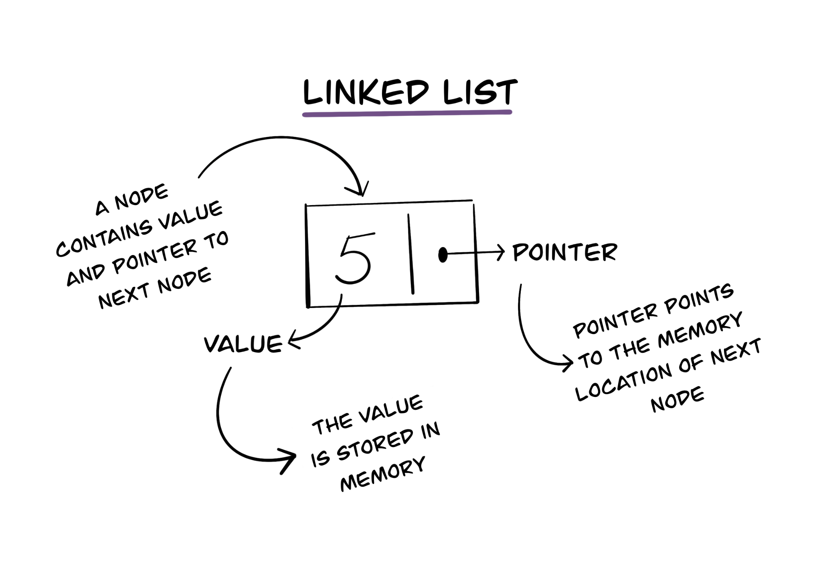

Slide 50
Components in Linked List
Head – Point to 1st Node
Tail – Point to Last Node
Node
Data
Reference

Slide 51
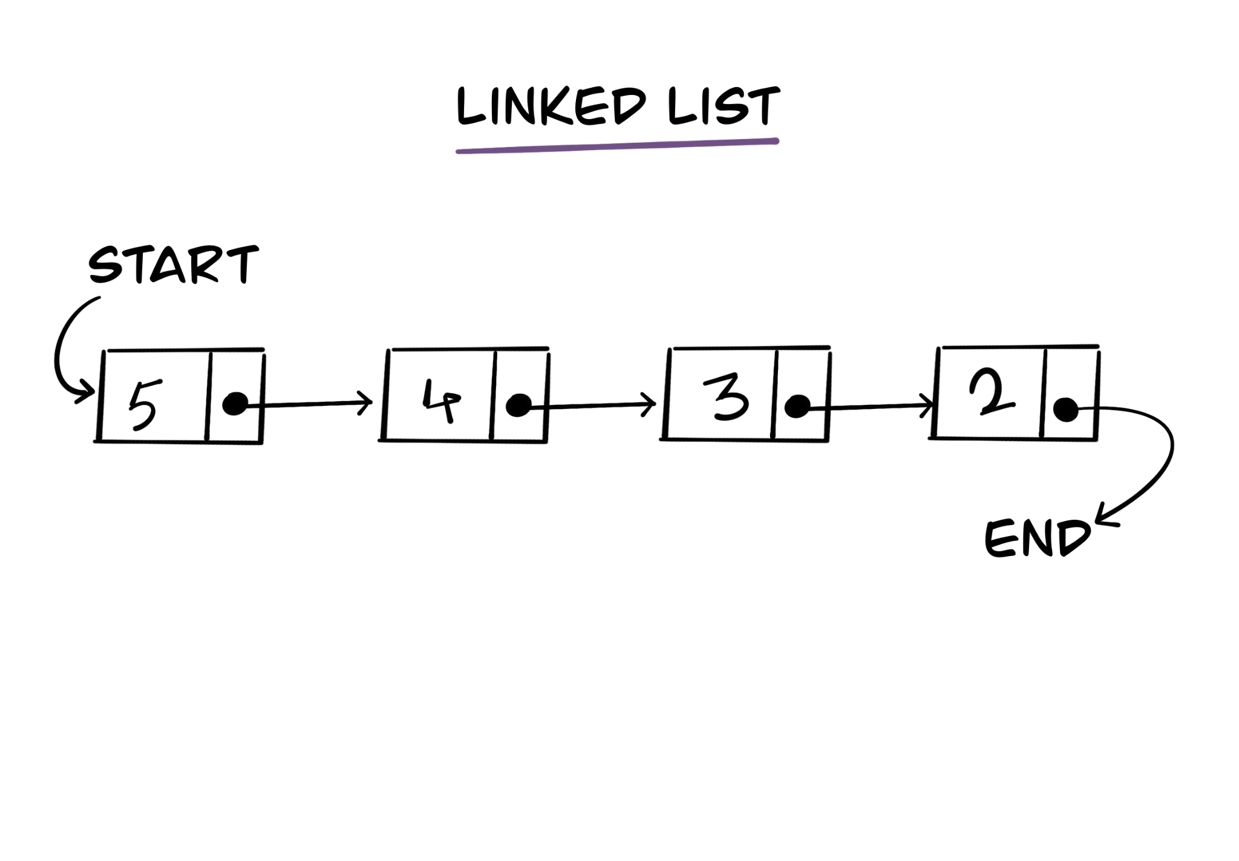

Slide 52
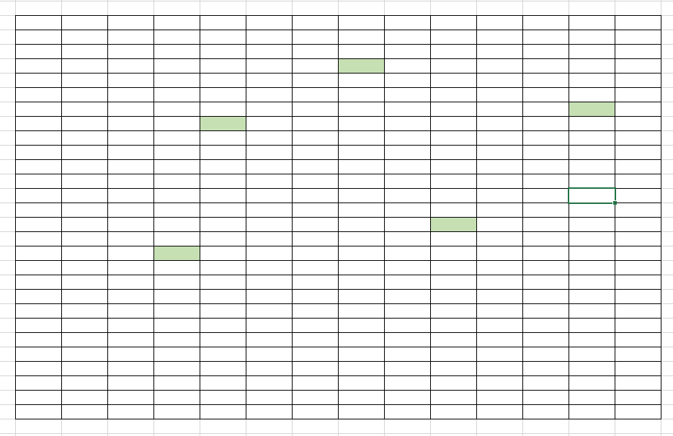
Link List Storage in Memory

Slide 53
Types of link list
Single Link List
In a single link list each node store the data and reference to the next node
Circular Single Link List
The last node of the link list refers to the first node
Double Link List
Each node refers to previous and next node
Circular Double Link List
Double Link List which is circular

Slide 54
Common Operations On Single LL
Creation of LL
Insertion of Data
Traversal
Searching a given Value
Deletion of Node
Deletion of Linked List

Slide 55
Creation
CreateSingleLL(nodeValue)
create head, tail initial value as Null ---- O(1)
create a blank node ------------------------- O(1)
node.data = nodeValue -------------------- O(1)
node.next = None --------------------------- O(1)
head = Node ---------------------------------- O(1)
tail = Node ------------------------------------- O(1)
Time Complexity – O(1)
Space Complexity – O(1)

Slide 56
Insertion
New Node at start of the Link List (before head)
New Node at end of the Link List (after tail)
New Node at specific location

Slide 57
Insert
InsertLinkList(head, nodeValue, Location)
create a blank Node
node.Value = nodeValue
if not existsLL()
return error
else if location is 0 //First Node
newNode.next = head
head = newNode
else if location equals last
newNode.next = null
tail.next = newNode
tail = newNode
else
loop tempNode = 0 to location – 1
newNode.next = tempNode.next
tempNode.next = newNode
Time Complexity : O(n)
Space Complexity : O(1)

Slide 58
Traversal
Traversal(head):
if !exsitsLL()
return
loop:head to tail
print currentNode.value
Time Complexity – O(n)
Space Complexity – O(1)

Slide 59
Search For a given value
Search(head, nodevalue)
loop: head to tail
if currentNode.value == nodeValue
print currentNode.value
return
return value not found
Time Complexity : O(n)
Space Complexity : O(1)

Slide 60
Delete a node
Delete first Node
When more than one node
When only one node
Delete last Node
When more than one node
When only one node
Delete Middle Node

Slide 61
Delete…
Time Complexity = O(n)
Space Complexity = O(1)
DeletionOfNode(head, location)
if !exisitLL()
return error
if location == 0
head = head.next
if this is the only element then update tail = null
else if location >= last
if only element then head=tail = null return
loop tmpNode till 2nd last element
tail = tmpNode
tmpNode.next = Null
else
loop tmpNode: 0 to location -1
tempNode.next = tempNode.next.next

Slide 62
Delete entire LL
deleteEntireLL(head)
head = null
tail = null
Time Complexity – O(1)
Space Complexity – O(1)

Slide 63
Circular LL
Common Operation
Creation
Insertion
Traversal
Searching
Deletion of a Node
Delete entire LL

Slide 64
Insert
InsertLinkList(head, nodeValue, Location)
create a blank Node
node.Value = nodeValue
if !existsLL()
return error
else if location is 0
node.next = head
head = node
tail.next = head
else if location equals last
node.next = head
tail.next = Node
tail = node
else
loop tempNode = 0 to location – 1
node.next = tempNode.next
tempNode.next = node

Slide 65
Traversal
Traversal(head):
if head == NULL
return
loop:head to tail
print currentNode.value
Time Complexity – O(n)
Space Complexity – O(1)

Slide 66
Search
Search(head, nodevalue)
loop: tempNode = head to tail
if tempNode.value == nodeValue
print tempNode.value
return
return value not found
Time Complexity : O(n)
Space Complexity : O(1)

Slide 67
Delete a node (1st , Last, Middle)
DeletionOfNode(head, location)
if !exisitLL()
return error
if location == 0
head = head.next
tail.next = head
if this is the only element then update head = tail = node.next = null
else if location >= last
if only element then head=tail = node.next null return
loop tmpNode till 2nd last element
tail = tmpNode
tmpNode.next = head
else
loop tmpNode: start to location -1
tempNode.next = tempNode.next.next

Slide 68
Usage
Implement Logical DS
**Python
It is a substitute for the array when the size is not known.
It is used in many programming languages to implements other language specific collections
In Java, HashMap -> the internal working of HashMap used linked list
In DB linked list is used to add relations/storage
B+ Tree along with linked list

Slide 69
Recursion

Slide 70


What is Recursion
Example from Non – Computing World:

Slide 71
Recursion Properties
Same operation being performed with different input
In every step we try to make the problem smaller
We mandatorily need to give a base condition
A condition which stops the recursion
Either found the answer
Answer does not exists
It is managed using stacks

Slide 72
Usage
Recursion simplifies implementation in many cases
Greatly used in below scenarios
Trees
Graphs
Dynamic Algorithm
Sorting Algorithms

Slide 73
Format
Recursive Case : Case where function recur with different (smaller) parameters
**Base Case : Case where the function does not recur (recursion stops)
SampleRecursion(parameter)
if base case
return some base case value
else
SampleRecursion(modifiedParameter)

Slide 74
Recursion Find Factorial
Definition
Factorial of non – negative integer n
Denoted by n!
Is the product of all positive integers from 1 to n
Example
5! = 1*2*3*4*5 = 120
6! = 1*2*3*4*5*6 = 720
0! = 1

Slide 75
Algo For Factorial
factorial(n)
if n equals 0
return 1
return n * factorial(n-1)

Slide 76
Time Complexity
Recursions

Slide 77
Calculate Time Complexity (O)
Iterative Algorithm
Recursive Algorithm

Slide 78
Iterative
Find the largest number in an array
largestNumber(arr):
largestNumber = Integer.Min------------------ O(1)
for i in range(0, len(arr)) ----------------------- O(n)
if arr[i] > largestNumber -------------- O(1)
largestNumber = arr[i] -------- O(1)
return largestNumber --------------------------- O(1)
Time Complexity = O(1) + O(n) + O(1) = O(n)

Slide 79
Recursive #1
Set global highest = Integer.Min (-99999999)
biggestNumber(A, index):
if index == -1
return highest
else
if A[index] > highest
highest = A[index]
return biggestNumber(A, index-1)

Slide 80
Recursive #1
biggestNumber(A, index): ----------------------------- (Say T(n))
if index == -1--------------------------------------- O(1)
return highest ---------------------------- O(1)
else -------------------------------------------------- O(1)
if A[index] > highest --------------------- O(1)
highest = A[index]--------------- O(1)
return biggestNumber(A, index-1)---- T(n-1)

Slide 81
Back Substitution
Back Substitution O(1) as 1
T(n) = 1 + T (n-1) ------------ Eq#1
T(-1) = 1 ----------------------- Base Condition
T(n-1) = 1 + T((n-1)-1) = 1 + T(n-2)----- Eq #2
T(n-2) = 1 + T((n-2)-1) = 1 + T(n-3) ----- Eq #3
T(n) = 1 + T(n-1)
= 1 + (1+T(n-2)) = 2 + T(n-2)
= 2 + (1 + T(n-3)) = 3 + T(n-3)
= k + T(n-k)
= n + 1 + T(n- (n+1)) [select a value of k such that T is removed]
= n + 1 + T(-1)
= n + 1 + 1
= n + 1
= O(n)

Slide 82
Example 2 (Binary Search)
Find a number in a sorted array
Binary Search

Slide 83
Algo
binarySearch(arr, findNumber, start, end)
if start == end
if arr[start] == findNumber
return start
else
return error not present
mid = findmid(arr, start, end) # Return the index
if findnumber < arr[mid]
binarySearch(arr, findNumber, start, mid)
else if findNumber > arr[mid]
binarySearch(arr, findNumber, mid+1, end)
else if arr[mid] == findNumber
return mid

Slide 84
Binary Search Time Complexity
binarySearch(arr, findNumber, start, end) ----------------------------- T(n)
if starts = end ------------------------------------------------------- O(1)
if arr[start] == findNumber ---------------------------- O(1)
return start -------------------------------------- O(1)
else --------------------------------------------------------- O(1)
return error not present --------------------- O(1)
mid = findmid(arr, start, end) ---------------------------------- O(1)
if arr[mid] > findnumber ---------------------------------------- O(1)
binarySearch(arr, findNumber, start, mid) --------- T(n/2)
else if arr[mid] < findNumber ---------------------------------- O(1)
binarySearch(arr, findNumber, mid+1, end) ------- T(n/2)
else if arr[mid] == findNumber --------------------------------- O(1)
return mid ------------------------------------------------- O(1)

Slide 85
Equations
T(n) = T(n/2) + 1 ------------ Eq(#1)
T(1) = 1 ---------------------- Base Equation
T(n/2) = T(n/4) + 1 ----------- (#2)
T(n/4) = T(n/8) + 1 ----------- (#3)
T(n) = T(n/2) + 1
= (T(n/4) + 1) + 1 = T(n/4) + 2
= (T(n/8) + 1) + 2 = T(n/8) + 3
= T(n/2^k) + k
= T(1) + log(n) = 1 + log(n) = log(n)
Element T function
n/2^k = 1
n= 2^k
k = log(n)

Slide 86
Advanced DS

Slide 87
Searching & Sorting
Linear Search
Binary Search
Bubble Sort
Insertion Sort
Selection Sort

Slide 88
Linear Search
Linear_search(arr, n, search_value)
for i = 0 to n-1
if arr[i] == search_value
print(“Value found”)
return
print(“Value not found”)
Time Complexity = O(n)
Space Complexity = O(1)

Slide 89
Binary Search
Find a number in a Sorted array
Binary Search

Slide 90
Algo(Recursion)
binarySearch(arr, findNumber, start, end)
if start == end
if arr[start] == findNumber
return start
else
print(“Data is not present)”
return
mid = findmid(arr, start, end) # Returning the middle index
if findnumber < arr[mid]
binarySearch(arr, findNumber, start, mid)
else if findNumber > arr[mid]
binarySearch(arr, findNumber, mid+1, end)
else if arr[mid] == findNumber
return mid

Slide 91
Complexity
Time Complexity = O(logn)
Space Complexity = O(1)

Slide 92
Binary Search Time Complexity
binarySearch(arr, findNumber, start, end) ----------------------------- T(n)
if starts = end ------------------------------------------------------- O(1)
if arr[start] == findNumber ---------------------------- O(1)
return start -------------------------------------- O(1)
else --------------------------------------------------------- O(1)
return error not present --------------------- O(1)
mid = findmid(arr, start, end) ---------------------------------- O(1)
if arr[mid] > findnumber ---------------------------------------- O(1)
binarySearch(arr, findNumber, start, mid) --------- T(n/2)
else if arr[mid] < findNumber ---------------------------------- O(1)
binarySearch(arr, findNumber, mid+1, end) ------- T(n/2)
else if arr[mid] == findNumber --------------------------------- O(1)
return mid ------------------------------------------------- O(1)

Slide 93
Equations
T(n) = T(n/2) + 1 ------------ Eq(#1)
T(1) = 1 ---------------------- Base Equation
T(n/2) = T(n/4) + 1 ----------- (#2)
T(n/4) = T(n/8) + 1 ----------- (#3)
T(n) = T(n/2) + 1
= (T(n/4) + 1) + 1 = T(n/4) + 2
= (T(n/8) + 1) + 2 = T(n/8) + 3
= T(n/2^k) + k
= T(1) + log(n) = 1 + log(n) = log(n)
Element T function
n/2^k = 1
n= 2^k
k = log(n)

Slide 94
Sorting

Slide 95
What is sorting
Arrange the given data in a particular format
Ascending order
Descending order
Where do we find sorting
Excel
Online Shopping
Sort by Price low to high
Sort by Price high to low

Slide 96
Types of Sorting
Sorting
Depending on Space
Depending on Stability
In Place
Out-of Place
Stable
Un Stable

Slide 97
Types of Sorting
In Place Sorting
Does not require any additional space for sorting
Example : Bubble Sort
Out Place
Does require additional space for sorting
Example : Merge Sort

Slide 98
Type of Sorting
Stable Sort
If a sorting algorithm after sorting the contents does not change the sequence of similar content in which they appear is called Stable Sorting
Example : Insertion Sort
Un Stable Sort
If a sorting algorithm after sorting the contents does changes the sequence of similar content in which they appear is called Un stable Sorting
Example : Quick Sort

Slide 99
Bubble Sort
Also know as Sinking Sort
Repeatedly steps through the list to be sorted, compares each pair of adjacent items and swaps them if they are in wrong order.

Slide 100
Algorithm
bubbleSort(arr):
n = arr.length
for i in 0 to n-1
for j in 0 to n-i-1
if arr[j] > arr[j+1]
swap(arr[j], arr[j+1])

Slide 101
Complexity
bubbleSort(arr):
n = arr.length ----------------------------------------- O(1)
for i in 0 to n-1 ---------------------------------------- O(n)
for j in 0 to n-i-1 ------------------------------- O(n)
if arr[j] > arr[j+1] ----------------------- O(1)
swap(arr[j], arr[j+1]) ----------- O(1)
Time Complexity – O(n^2)
Space Complexity – O(1)

Slide 102
When to Use/Not Use
Use
Space is concern
Easy to implement
Not Use
Average Time Complexity is poor

Slide 103
Selection Sort
Is based on idea of finding the minimum or maximum element in the an unsorted array and then putting it in the correct position in a sorted array
Breaks into sorted and un-sorted array

Slide 104
Selection Sort
selectionSort(arr):
loop: j = 0 to n-1:
iMin = j
loop: i = j+1 to n-1
if arr[i] < arr[iMin]
iMin = i
if iMin != j
swap(arr[j], arr[iMin])

Slide 105
Complexity
selectionSort(arr):
loop: j = 0 to n-1: ------------------------------------- O(n)
int iMin = j -------------------------------------- O(1)
loop: i = j+1 to n-1 ---------------------------- O(n)
if arr[i] < arr[iMin] --------------------- O(1)
iMin = I --------------------------- O(1)
if iMin != j ---------------------------------------- O(1)
swap(arr[j], arr[iMin]) ----------------- O(1)
Time Complexity : O(n^2)
Space Complexity : O(1)

Slide 106
When to use/not use
Use
No additional memory
Easy to implement
Not use
When time complexity is a concern

Slide 107
Insertion Sort
Divide the array in two part sorted and unsorted
Then from unsorted we pick the first element and find its correct position in sorted array
Repeat until unsorted array is empty

Slide 108
Algorithm
insertionSort(arr):
loop: i = 1 to n
currentNumber = arr[i]
j = i
while arr[j-1] > currentNumber && j > 0
arr[j] = arr[j-1]
j- -
arr[j] = currentNumber

Slide 109
When to use/not use
Use
No additional Memory
Simple Implementation
Not Use
When time complexity is to be considered

